Slide 1
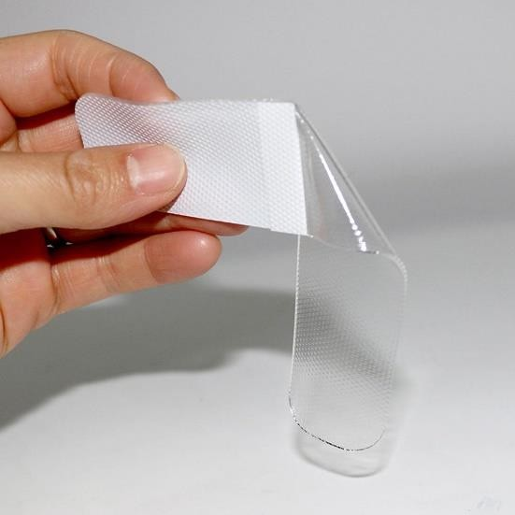
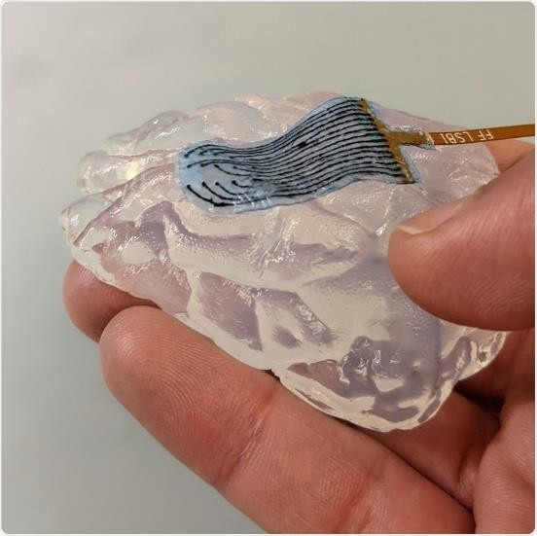
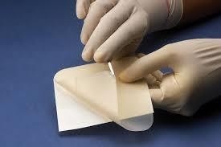
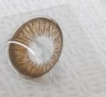
·· HEALTHCARE ·· WOUND-CARE ··
TMB Co., Ltd.
Specialized in Adhesive Materials for Human Skin
Hydro colloid
Silicone gel
MPC
Hydro gel

Slide 2
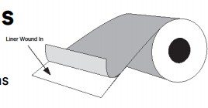


INTRODUCTION
Effective date of documents: August, 2026
Product Name | Solskin Silicone Roll Tape
Purpose | Wound protection and Fixing for medical treatments
Figure | Roll type
Structure | 2 Layers
Color | Opaque by surface of PU(polyurethane film)
Odor | No scent
Adhesive material | Silicone gel for medical
Base film | PU(polyurethane) film
Term of validity | 3 years after the date of production
Dustless Paper Tube
PU film
Adhesive Silicone Gel

Slide 3


COMPOSITION
Effective date of documents: August, 2026
Base - Polyurethane(PU) film, 50 and 100μm
Medical purpose
Properties as below
Properties | Test method | Result
Hardness | ASTM D2240 Shore A | 92
Tensile Strength | ASTM D412(Mpa) | 52
Tensile Stress | ASTM D412(Mpa):100% | 9
Elongation | ASTM D412(%) | 380
Tear Strength | ASTM D624(kg/mm) | 11
25.4mm
Adhesive Layer – Silicone gel, 250μm±10%
- Applications : Wound and Scar care, Surgical drapes, Wound protections
Dustless Paper Tube
White
Design printable
Tensile Strength (g) | ≥3,000
Adhesive force (gf/25mm) | ≥150

Slide 4
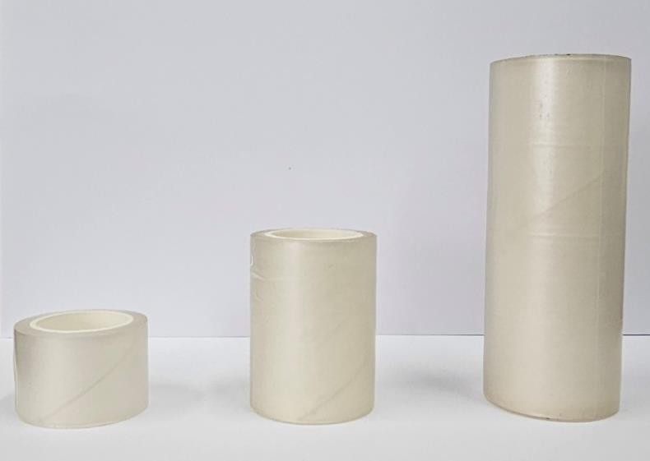
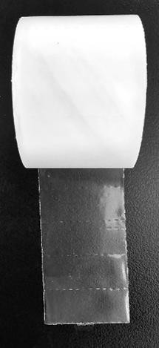
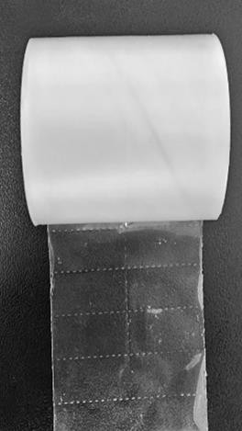
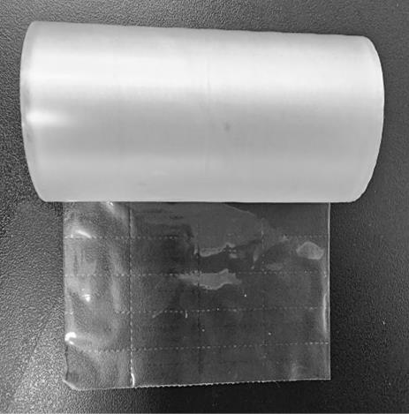
ROLL DISCRIPTION
Effective date of documents: August, 2026
Products Options
Products Standards
- Providing easy cutting line
Thickness | Standards | Adhesive force(gf/25mm) | 인장강도
 | 2.5cm*75cm
 | 2.5cm*150cm
 | 2.5cm*250cm
 | 5.0cm*75cm
220um±10% | 5.0cm*150cm | 19.17 | 3.42
 | 5.0cm*250cm
 | 10.0cm*75cm
 | 10.0cm*150cm
 | 10.0cm*250cm
Vertical Interval
10mm
Horizontal Spacing | 2.5cm | n/a
 | 5.0cm | Two-division
 | 10.0cm | Four-division

Slide 5
Adhesive Provide
Effective date of documents: August, 2026
Solskin Silicone Roll Tapes are two- component silicone gels that can be applied on a variety of substrates and cured into a soft adhesive layer bringing an atraumatic removal for the patients.
Silicone gel of Solskin Silicone Roll Tapes are manufactured in a clean environment to ensure healthcare grade levels purity and quality.
Silicone gel of Solskin Silicone Roll Tapes are biocompatible following the ISO 10993 standards.
Proven biocompatibility according to ISO 10993
No trauma upon removal
Reduced skin irritation versus traditional adhesives
Responsibility of the dressing up to 10 times
Reduced occurrence of MARSI
(Medical Adhesive Related Skin Injuries)
Reduced pain experienced by the patients

